Slide 1
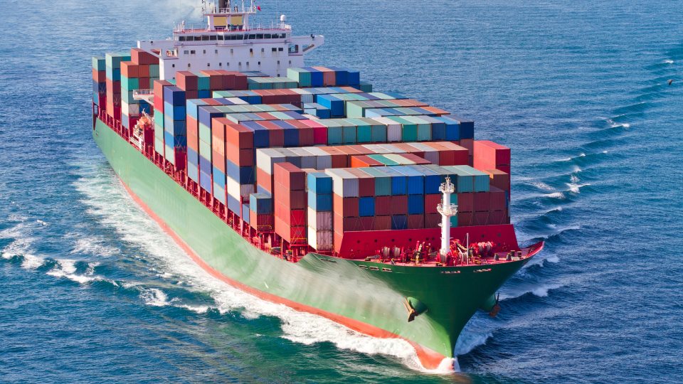
UK - US Trade Resiliency
Leveraging the Great Lakes St. Lawerence Seaway (GLS)
Jan Bauer, Consul
UK Government Office, Minnesota
Jan.Bauer@fcdo.gov.uk

Slide 2
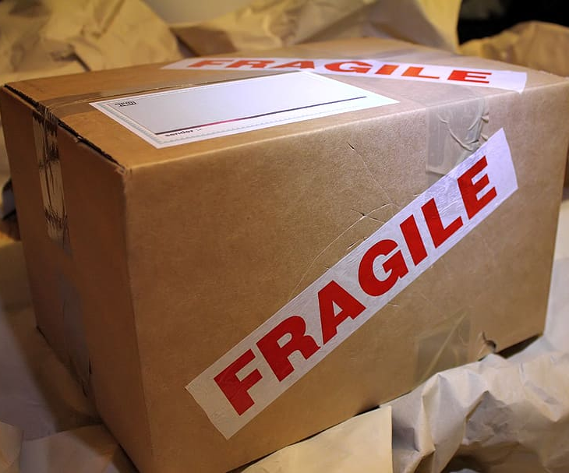
Est. a committee - Identify & Engage Midwest Exporters to the UK
Approved funding to bring exporters to UK - Feb. 2026 – Pilot Prog.
Welcome the ICM input and ideas

Slide 3
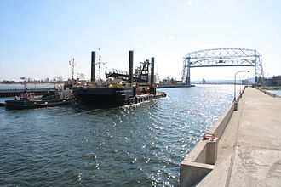
Key Points
UK and US Governments support this effort
Resiliency & Redundancy– Now more than Ever!
A supply chain insurance policy
Develop a supply chain with versatility, resiliency & redundancy in an already challenged supply chain.
Great Lakes Pilot Program –
Early Adopter
Trip to UK
Media Attention

Slide 4
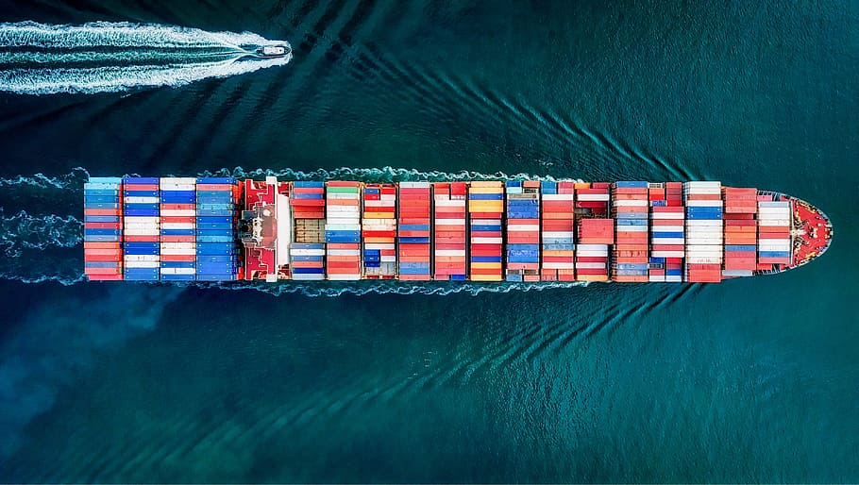
Key Points
Green Your Supply Chain
40-60% CO2 reductions, depending on mode and route (reducing rail and/or truck)
Unique value proposition: Company can demonstrate they are reducing their carbon footprint UK and US Governments support this effort
Improved door-to-door travel times - avoid coastal port congestion
Duluth to UK - 2 weeks vs 4-6 weeks via east coast ports. Cleveland to UK - 7-10 days vs 2-3 weeks Cash is King! $ Goods in consumers hands faster means sellers get paid faster
Challenges
Need 6-8 exporters, each side of the pond to join Pilot Program
Smaller Ships required (Handi-Max) to fit through 15 Locks
Closure mid-January to mid-March for lock maintenance

Slide 5
Please contact me with your ideas, export contacts and any other support.
Thank you!
Jan Bauer, Consul
UK Government Office, Minnesota
Jan.Bauer@fcdo.gov.uk

